Slide 1
أكـــــاديميــــة طــــويـــق
Deep Learning

Slide 2
Object Detection With
Faster-RCNN & SSD
By: Dr. Afshan Hashmi

Slide 3
Course Objectives:
Understanding Object Detection with Faster RCNN and SSD
Features of Faster RCNN and SSD
Architecture of Faster RCNN and SSD
Working of Faster RCNN and SSD
Comparison of Faster RCNN and SSD
Implementing of Faster RCNN and SSD

Slide 4
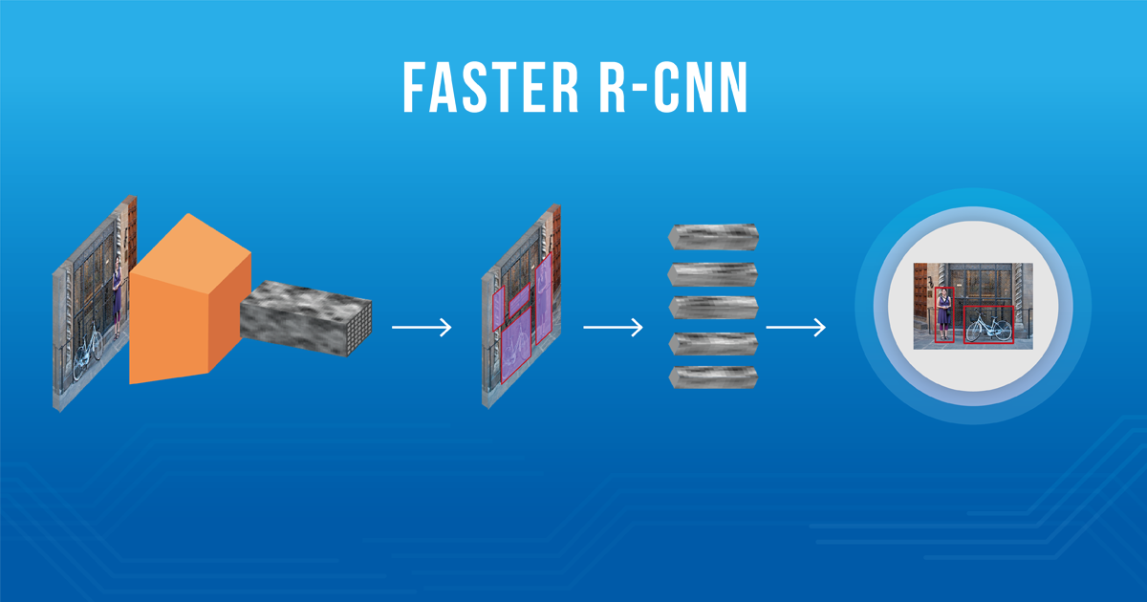
Faster R-CNN
Faster R-CNN is a two-stage object detector.
Stage 1 (Region Proposal Network - RPN): Proposes potential regions within the image that are likely to contain objects.
Stage 2: Uses the proposed regions from Stage 1 to: Predict the class (category) of the object within each region.
Refine the bounding box coordinates to better fit the detected object.

Slide 5
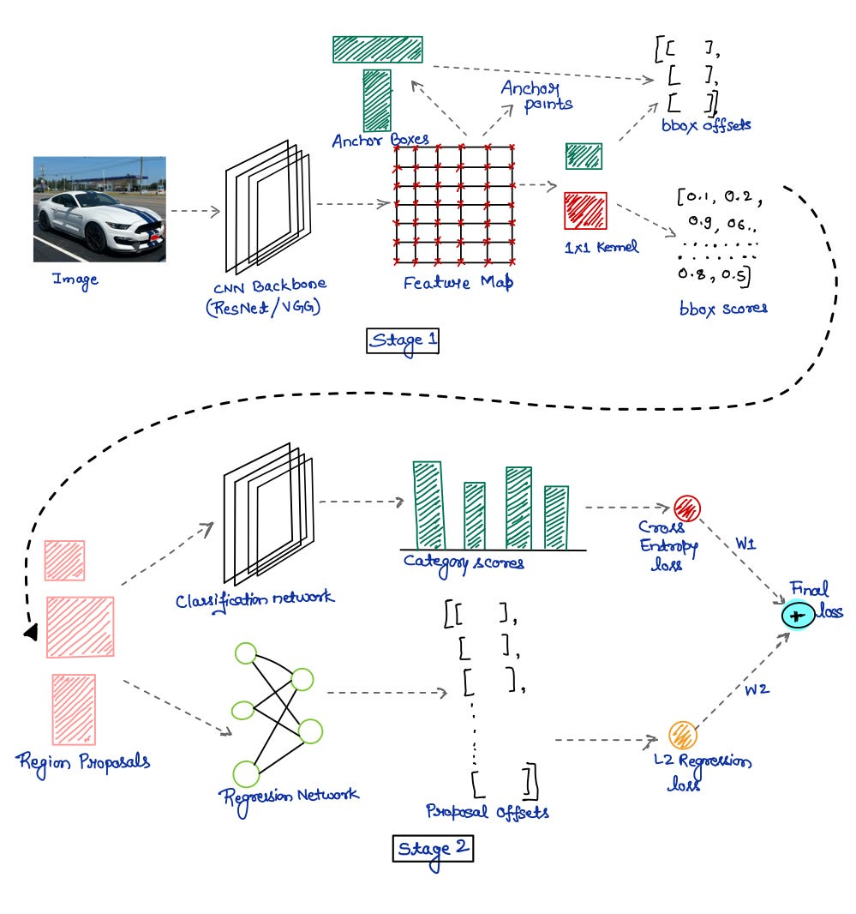
The Architecture of Faster R-CNN

Slide 6
Stage 1: Region Proposal Network (RPN): Backbone Network: The image passes through a convolutional network (like ResNet or VGG16). This extracts important features from the image and creates a feature map. Anchors: Anchors are boxes of different sizes and shapes placed over points on the feature map. Each anchor box represents a possible object location. At every point on the feature map, anchor boxes are generated with different sizes and aspect ratios. Bounding Box Refinement: The RPN also refines the anchor boxes to better align them with the actual objects by predicting offsets (adjustments).

Slide 7
Stage 1: Region Proposal Network (RPN):
Classification of Anchors:
The RPN predicts whether each anchor box is background (no object) or foreground (contains an object).
Positive (foreground) anchors: Boxes with high overlap with actual objects.
Negative (background) anchors: Boxes with little or no overlap with objects.
Loss functions:
I)Classification loss: Helps the model decide if the anchor is background or foreground.
II)Regression loss: Helps adjust the anchor boxes to fit the objects more precisely.

Slide 8
Stage 2: Object Classification and Box Refinement:
Region Proposals:
After RPN, we get region proposals (refined boxes that likely contain objects).
ROI Pooling:
The region proposals have different sizes, but the neural network needs fixed-size inputs.
ROI Pooling resizes all region proposals to a fixed size by dividing them into smaller regions and applying pooling, making them uniform.
Object Classification:
Each region proposal is passed through a small network to predict the category (e.g., dog, car, etc.) of the object inside it.
Cross-entropy loss is used to classify the objects into categories.

Slide 9
Stage 2: Object Classification and Box Refinement:
Bounding Box Refinement (Again):
The region proposals are refined again to better match the actual objects, using offsets.
This uses regression loss to adjust the proposals.
Multi-task Learning:
The network in stage 2 learns both to predict object categories and refine bounding boxes at the same time.
Inference (Testing/Prediction Time):
Top Region Proposals: During testing, the model generates a large number of region proposals, but only the top proposals (with the highest classification scores) are passed to the second stage.
Final Predictions: The second stage predicts the final categories and bounding boxes.
Non-Max Suppression: A technique called Non-Max Suppression is applied to remove duplicate or overlapping boxes, keeping only the best ones.

Slide 10
Stage 2: Object Classification and Box Refinement:
2. Final Predictions: The second stage predicts the final categories and bounding boxes.
3. Non-Max Suppression: A technique called Non-Max Suppression is applied to remove duplicate or overlapping boxes, keeping only the best ones.
Training:
Two ways to train:
Train in stages: First, train the region proposal network (RPN) and then the classifier and regressor.
Train together: Train both stages at the same time (faster and more efficient)

Slide 11
Key Components of Faster R-CNN
1. Backbone (Feature Extractor)
A pre-trained CNN like ResNet-50 or VGG16 is used to extract features from the input image.
Output: a feature map representing the spatial layout of the image.
2. Region Proposal Network (RPN)
Takes the feature map and proposes candidate object regions (bounding boxes).
It predicts:
Objectness score (Is it an object or background?)
Bounding box coordinates (refinements)
It uses anchors (predefined boxes of various sizes and aspect ratios) at each location in the feature map.
3. RoI Pooling (Region of Interest Pooling)
Takes the proposed regions and warps them into a fixed size, so they can be processed by the classifier regardless of shape.
This allows batching and consistent input size.
4. Fast R-CNN Head (Classifier + Regressor)
Classifies each RoI into object categories.
Refines the bounding box prediction for each detected object.

Slide 12
Advantages of Faster R-CNN
End-to-end trainable.
Fast compared to older R-CNN versions.
High accuracy on datasets like COCO, PASCAL VOC.

Slide 13
Single Shot Detector (SSD)
Object Detection Task: SSD addresses the critical computer vision task of identifying and locating objects within an image.
Traditional Methods Limitation: Earlier object detection methods were computationally expensive and slow due to requiring multiple passes over the image.
SSD's Core Idea: SSD revolutionized the field by performing object detection in a single pass over the image, hence its name.
Benefits of Single-Shot Detection: This single-pass approach significantly speeds up the detection process while maintaining high accuracy.
Real-time Applications: The speed and accuracy of SSD make it a popular choice for real-time applications.

Slide 14
Key Concepts in SSD
Concept | Description
Single Pass | One forward pass through the network predicts bounding boxes and class scores.
Default Boxes | Predefined anchor boxes of various scales and aspect ratios are used to detect objects at different sizes.
Multi-Scale Feature Maps | SSD makes predictions at multiple layers in the CNN, allowing detection of objects at various scales.
Loss Function | Combines localization loss (Smooth L1) and confidence loss (cross-entropy) to train the model.

Slide 15
Single Shot Detector (SSD) architecture works:
1. Base Network:
Starts with a pre-trained CNN (like VGG16) for strong feature extraction.
Processes the input image to generate feature maps.
2. Extra Layers:
Adds more convolutional layers after the base network.
These layers progressively decrease in size.
They are responsible for detecting objects at different scales.
Each extra layer produces feature maps that contribute to the final detections.
3. Multi-scale Feature Maps:
Uses feature maps at various resolutions for detecting objects of different sizes.
Higher resolution maps detect smaller objects.
Lower resolution maps detect larger objects.
4. Default Boxes (Anchor Boxes):
Applies a set of default boxes (anchor boxes) with different aspect ratios and scales at each location in the feature maps.
For each default box, SSD predicts:
Class Scores: Likelihood of an object belonging to a specific class.
Bounding Box Offsets: Adjustments to refine the default box to better fit the object.

Slide 16
Single Shot Detector (SSD) architecture works:
5. Predictions:
For every default box, the model outputs:
Class Confidences: Probability of the box containing a particular object class.
Bounding Box Adjustments: Coordinates to fine-tune the default box's position and size.
6. Loss Function:
Combines two loss components:
Localization Loss (Lloc): Measures the accuracy of predicted bounding boxes compared to ground truth using Smooth L1 loss.
Confidence Loss (Lconf): Evaluates the confidence in the predicted class scores using softmax loss.
7. Non-Maximum Suppression (NMS):
A post-processing step to eliminate redundant, overlapping bounding boxes with lower confidence scores, keeping only the most confident and relevant detections.

Slide 17
Steps in Single Shot Detection Input Image: The image is passed through the base network to extract feature maps. Feature Extraction: The extra layers process these maps at multiple scales. Default Boxes Assignment: Default boxes of various sizes and aspect ratios are assigned to each feature map cell. Prediction: For each default box, class scores and bounding box offsets are predicted. Loss Calculation: The loss is computed based on localization and confidence. NMS: Redundant boxes are removed to produce the final set of detections.

Slide 18
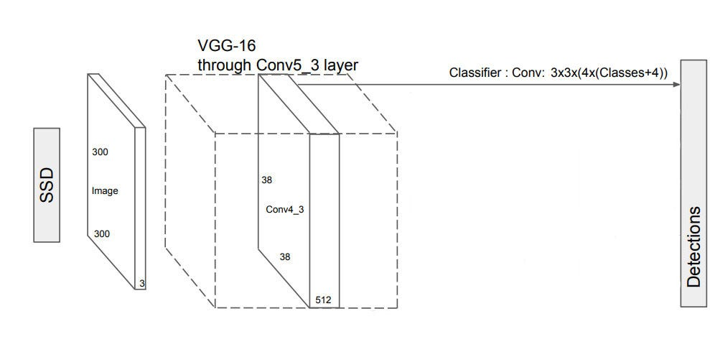
Single Shot Detector (SSD)
The SSD object detection composes of 2 parts:
Extract feature maps, and
Apply convolution filters to detect objects.

Slide 19
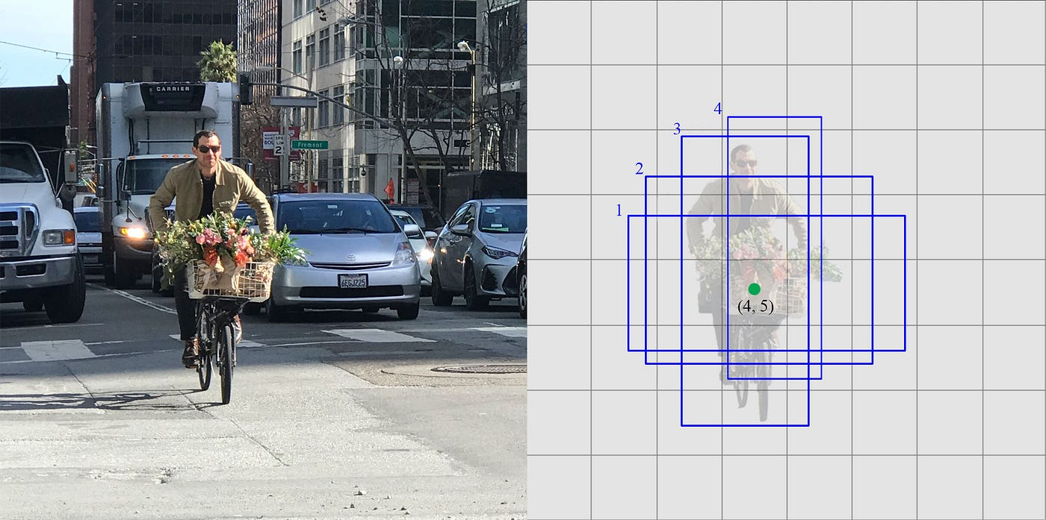
Single Shot Detector (SSD)
SSD uses VGG16 to extract feature maps. Then it detects objects using the Conv4_3 layer. For illustration, we draw the Conv4_3 to be 8 × 8 spatially (it should be 38 × 38). For each cell (also called location), it makes 4 object predictions.as shown in the figure:

Slide 20
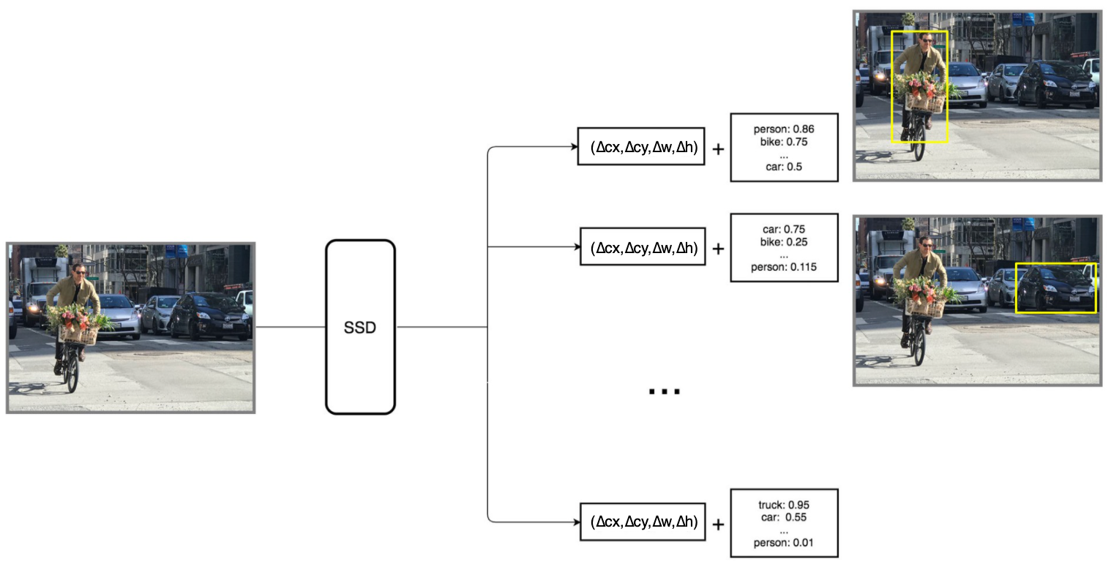
Single Shot Detector (SSD)
Each prediction composes of a boundary box and 21 scores for each class (one extra class for no object), and we pick the highest score as the class for the bounded object. Conv4_3 makes a total of 38 × 38 × 4 predictions: four predictions per cell regardless of the depth of the feature maps. As expected, many predictions contain no object. SSD reserves a class “0” to indicate it has no objects.

Slide 21
Single Shot Detector (SSD)
Each prediction composes of a boundary box and 21 scores for each class (one extra class for no object), and we pick the highest score as the class for the bounded object. Conv4_3 makes a total of 38 × 38 × 4 predictions: four predictions per cell regardless of the depth of the feature maps. As expected, many predictions contain no object. SSD reserves a class “0” to indicate it has no objects.

Slide 22
Single Shot Detector (SSD) Vs Faster RCNN
Aspect | SSD | Faster R-CNN
Speed | Faster (real-time) | Slower
Accuracy | Slightly lower | Higher
Architecture | Single-stage | Two-stage
Use Case | Real-time systems (e.g. mobile, robotics) | High-accuracy detection

Slide 23

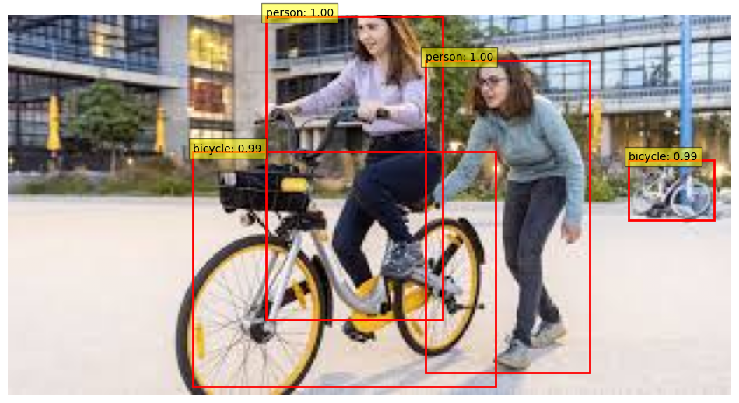
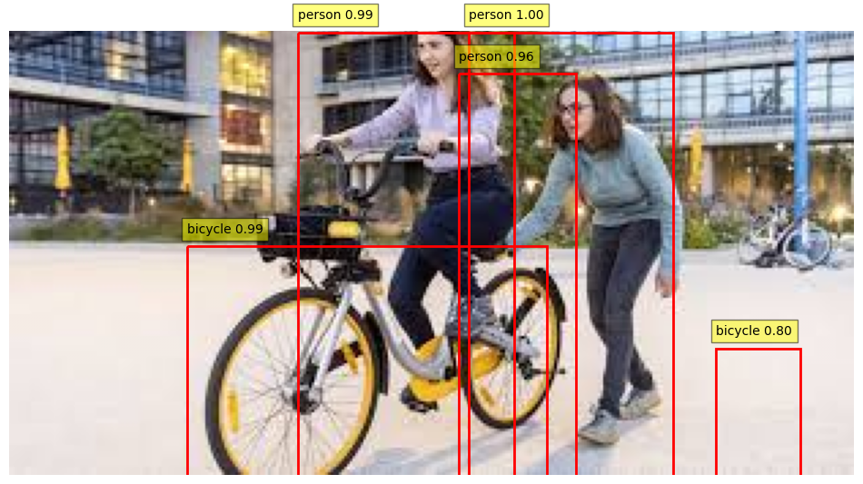
Comparison Table
Faster R-CNN- It is Visible that its more accurate | SSD- Not that accurate as compared to Faster R-CNN

Slide 24
Comparison Table
Feature | Faster R-CNN | SSD (Single Shot Detector) | YOLO (You Only Look Once)
Detection Type | Two-stage | One-stage | One-stage
Speed | Slower | Faster | Fastest
Accuracy | Higher | Medium | Medium
Region Proposals | Yes (RPN) | No | No
Best Use Case | High accuracy | Real-time, medium accuracy | Real-time applications

Slide 25

Hands On Exercise
Click Here For The Implementation on Google Colab
https://drive.google.com/file/d/1BtBen-9rjjuvaHL6d6dvQ6MRti_zd2fn/view?usp=share_link

Slide 26
Books and References
"Deep Learning" (Ian Goodfellow et al.)
"Neural Networks and Deep Learning" (Michael Nielsen)
Deep Learning for Computer Vision (Rajalingappaa Shanmugamani)
Courses: CS231n (Stanford), Fast.ai
Datasets: COCO, Pascal VOC, Cityscapes
www.medium.com
https://www.geeksforgeeks.org/how-single-shot-detector-ssd-works/

Slide 27

















الشراكات العالمية

Slide 28
شــــــكــــرًا لكــــــم
THANK YOU

